Slide 1

Olist Store Analysis
Prepared by :-
Eshwar j
Kaveri Wawage
Devendra Singh
Prasanna Dalvi

Slide 2
Content
Introduction
Objective
Data Process
KPI Slide with visuals
Challenges
Recommendation
Conclusion

Slide 3
Introduction
Olist is a Brazilian e-commerce platform that connects small and medium-sized businesses to larger marketplaces, enabling them to reach a broader customer base and expand their sales opportunities. As an intermediary platform, Olist provides a range of services including product listing, order management, logistics, and customer service support.
Overall, conducting a thorough analysis of Olist store performance important KPI and essential for identifying strengths, weaknesses, and opportunities for growth. By leveraging data-driven insights, merchants can make informed decisions to optimize their Olist store strategy and maximize sales potential.

Slide 4
OBJECTIVE
Objective of this project is to study the dataset to gain insights within the e-commerce platform. Specifically ,this aims to achieve the following objective : Weekday vs Weekend Payment Statistics, Orders with Review score 5 and Credit Card Payment, Average days to delivered for Pet Shop, Average Price and Payment Value for Sao Paulo City, Relationship between Review Score and Shipping Days. By achieving these objectives, the project aims to provide valuable insights, for contributing to this platform’s overall efficiency and profitability.

Slide 5
Data Process
Data Collection and Cleaning
Gather the data from source and identify the data accuracy, integrity
Data Integration:
Merge data from multiple sources to create a unified dataset for analysis. This may involve matching records based on common identifiers.
Exploratory Data Analysis (EDA):
Visualize data using charts, graphs, and dashboards to explore patterns, correlations, and outliers.

Slide 6
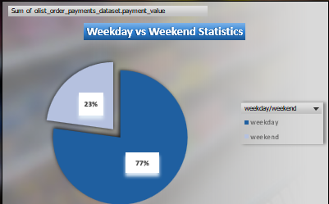
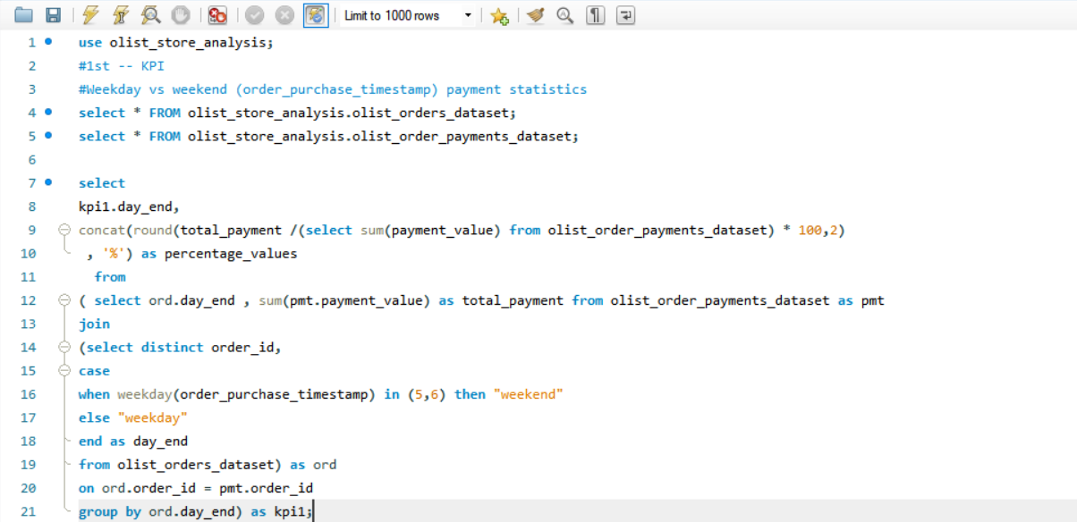
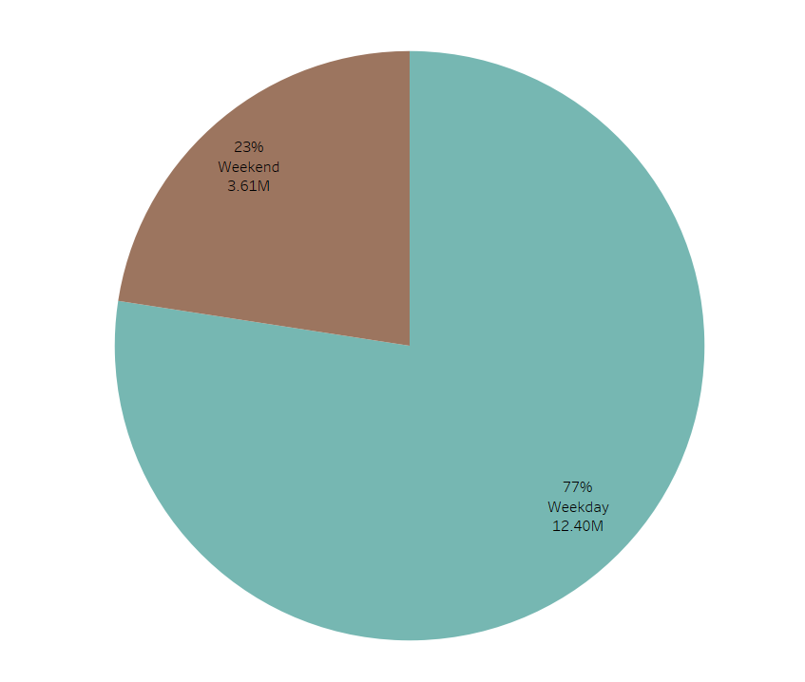
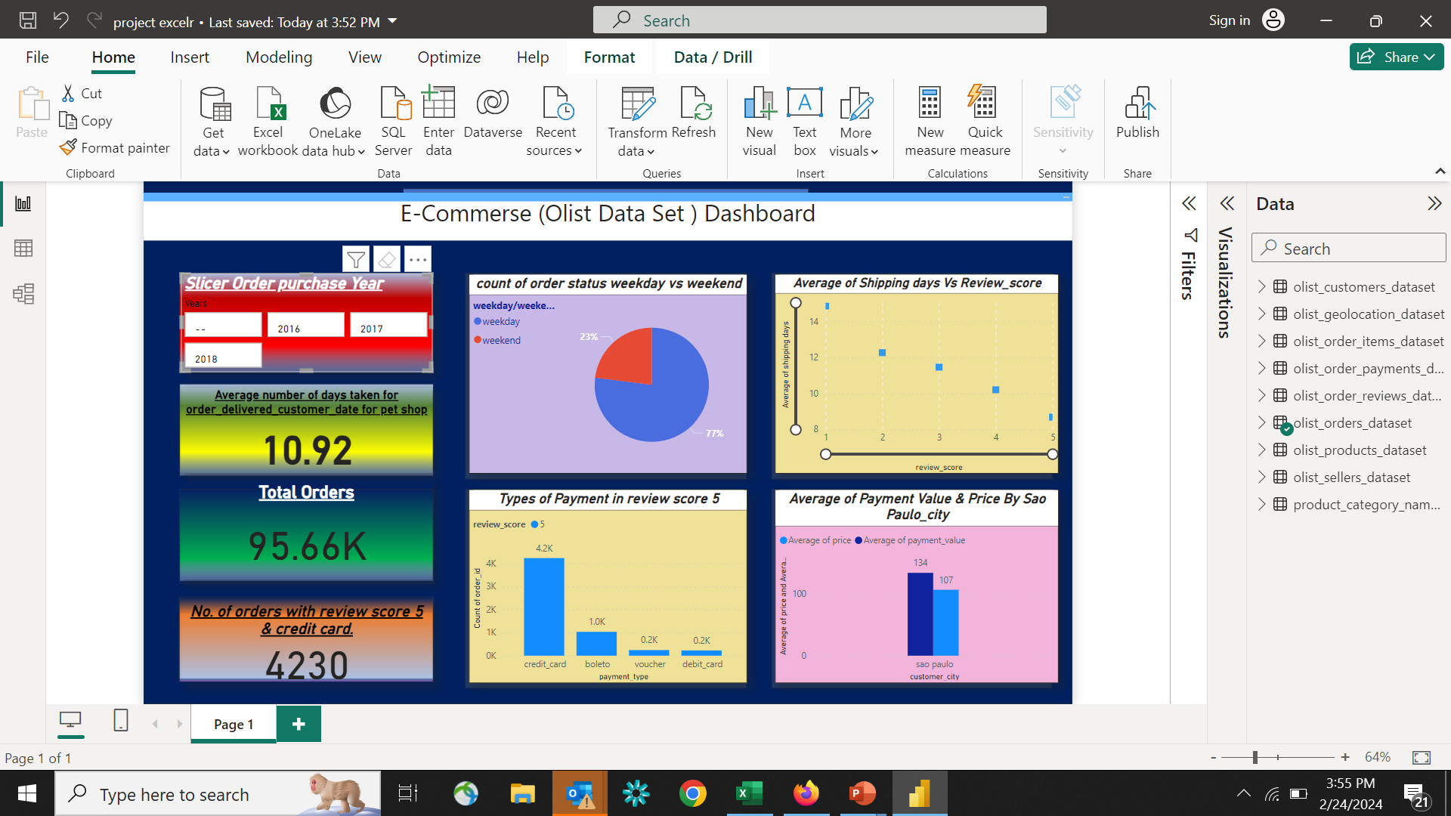
KPI’S WITH VISUALS
KPI 1:-Weekday vs weekend payment statistics
This KPI clearly illustrates the proportion of payments made on weekdays versus weekends, with the majority of payments occurring during weekdays (77%) and a smaller portion during weekends (23%)

Slide 7
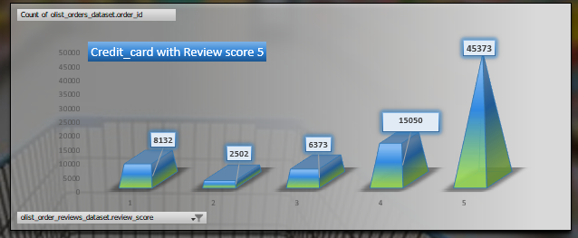
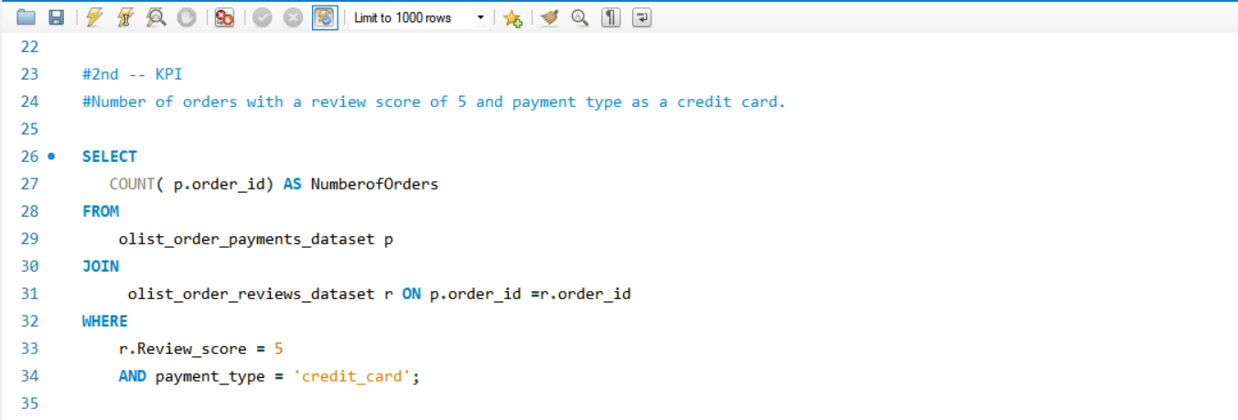
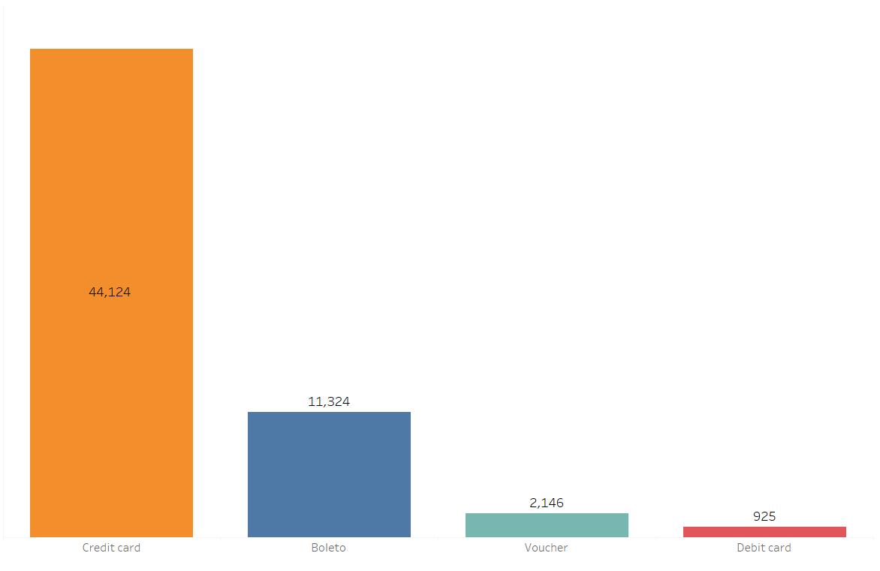
KPI 2:- Orders with a Review score 5 and Credit Card Payment
This KPI represents a comparison between different payment methods, where the customer gives a review score of 5 as well as payment through credit card is 44,124.

Slide 8
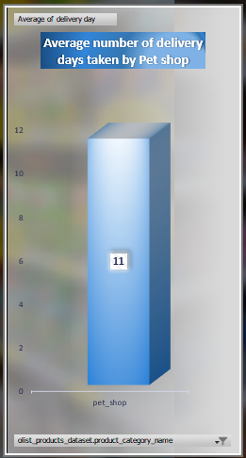
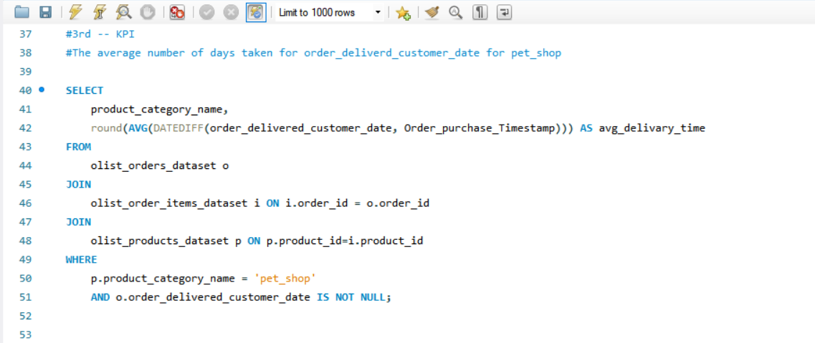
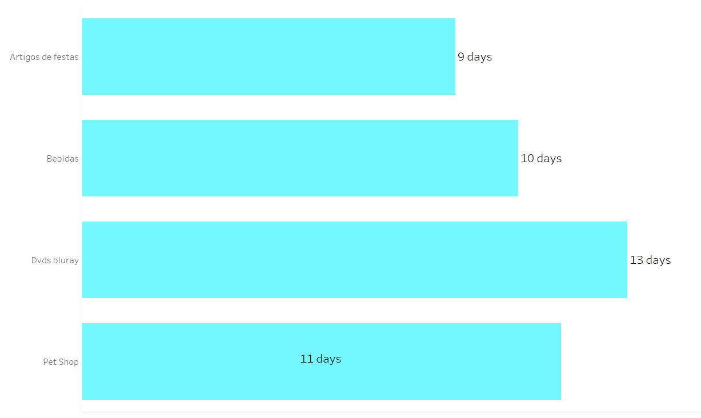
KPI 3:- Average days to delivered for pet shop
As it appears in these Kpi’s , pet shop takes total average of 11 days for delivary.

Slide 9
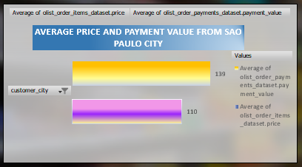
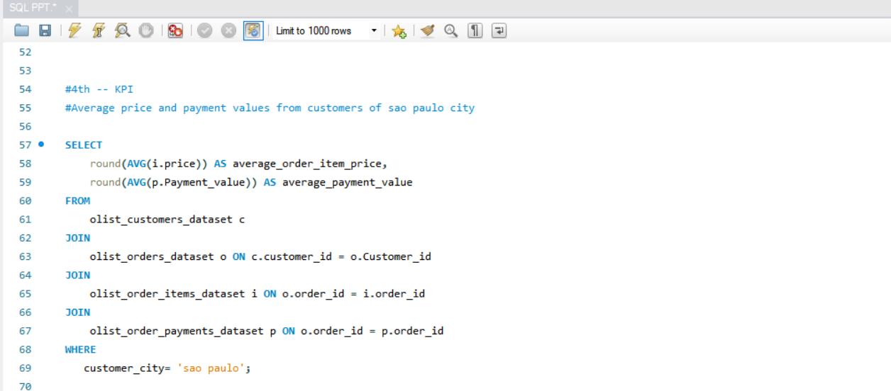
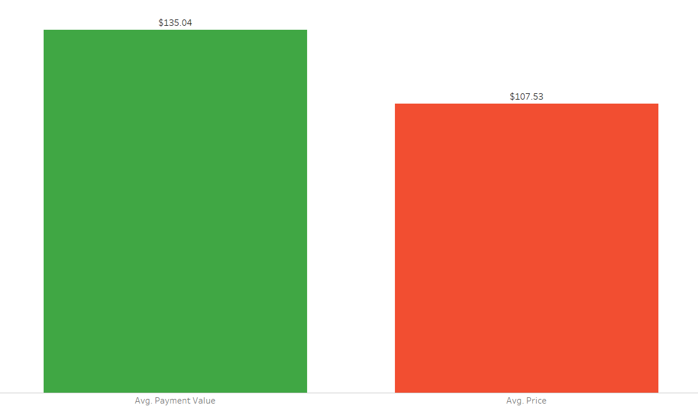
KPI 4: Average Price and Payment Value for Sao Paulo City
These KPI shows average price of Sao Paulo city which is $107.53 less than average payment value i. e $135.04.

Slide 10
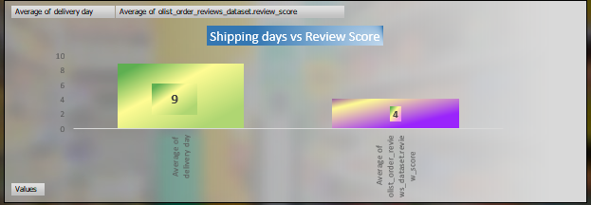
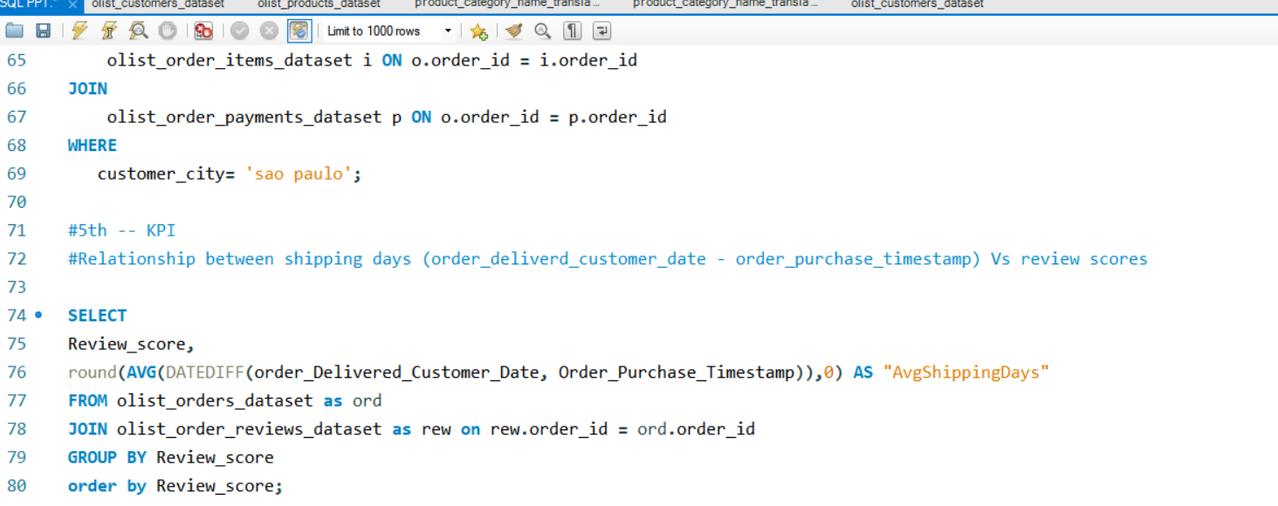
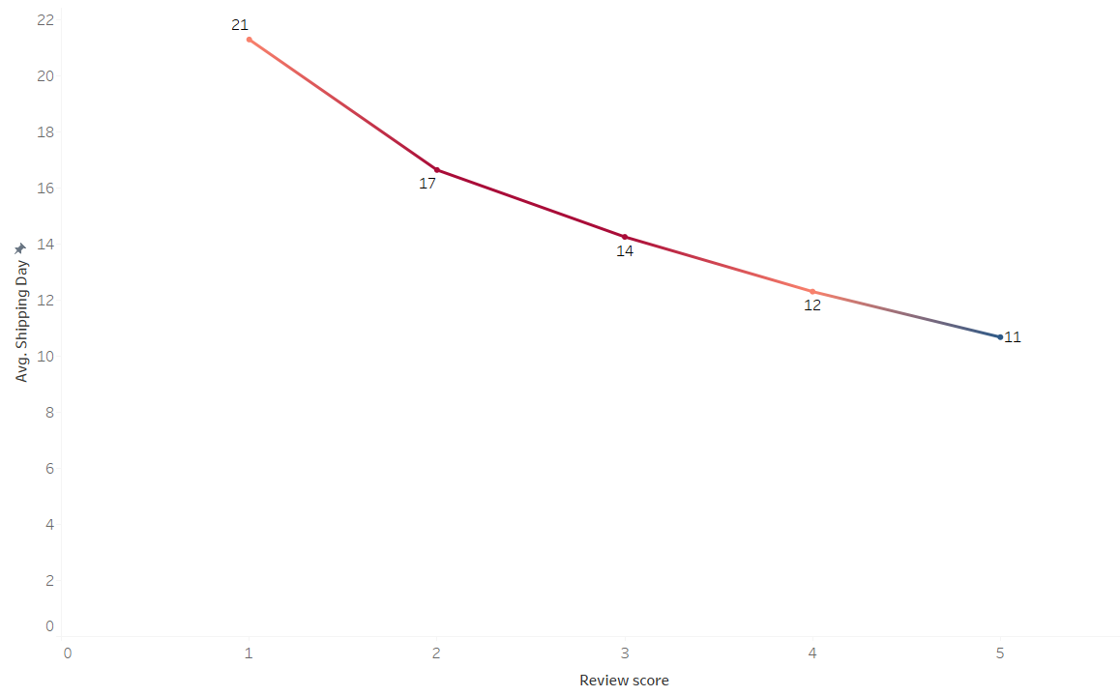
KPI 5:- Relationship between Review Score and Shipping Days
This is a illustration of average shipping days to review score, clearly showing us that 21 is the most shipping days getting review score of 1, and 11 is the least getting review score 5.

Slide 11
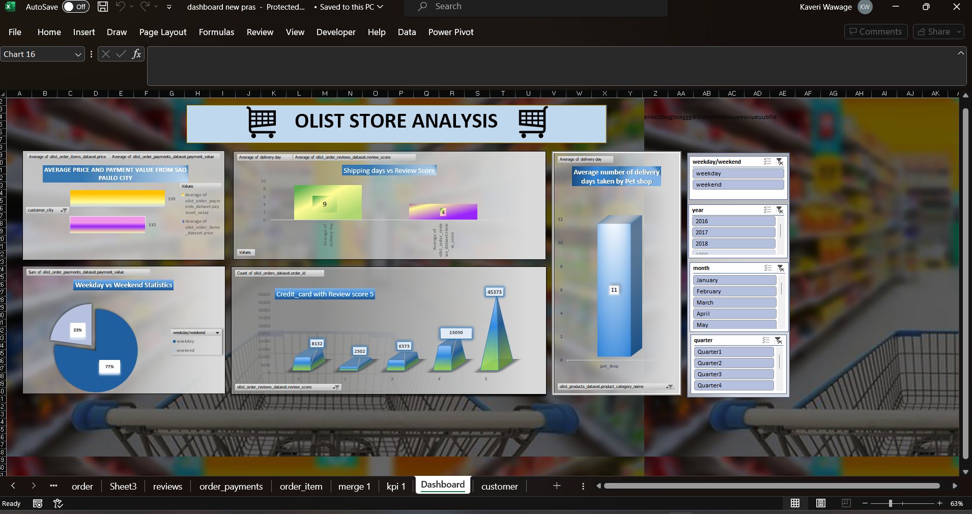
Dashboards
Excel:-

Slide 12
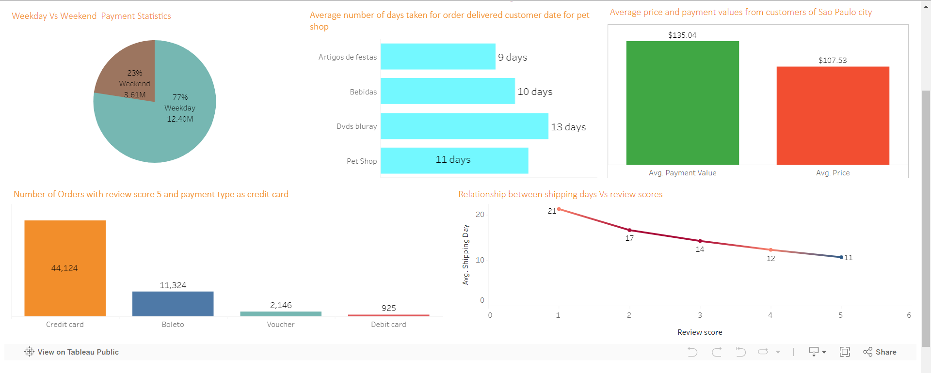
Tableau:-

Slide 13
Powerbi:-

Slide 14
Challenges
Data cleaning: Removing unwanted fields from the datasets.
Data Integration: Combining and reconciling data from multiple sources.
Visualization and Interpretation: Communicating insights effectively through data visualization and interpretation is crucial for decision-making. However, presenting complex e-commerce data in a clear and understandable manner can be challenging, requiring expertise in data visualization tools and techniques.

Slide 15
Recommendations
To increase sales give more discount for customers who payment through credit card
We have focus to reduce the delivery days to get good review score
Based on the analysis, provide recommendations to optimize shipping processes, improve customer satisfaction, and potentially enhance review scores. This might include streamlining logistics, improving communication with customers, or offering expedited shipping options.

Slide 16
Conclusion
In this conclusion we identified several key factors influencing customer conversion rates on our e-commerce platform. By implementing the recommended actions, this analysis provided valuable insights, it's important to recognize limitations such as missing data, format and quality.
While our analysis revealed positive trends in customer engagement, further research is needed to explore the impact of personalized product recommendations on long-term customer loyalty.

Slide 17

THANK YOU

